Slide 1
Biodiversity Study
Jeffrey A. Egan
9 August 2018
Capstone Project Produced for Code Academy
Intro to Data Analysis - Pro Intensive Course
Cohort Class Starting on 19 June 2018

Slide 2
Biodiversity Study Agenda
Directing Protected Species Conservation Efforts
Overview of Species Data Records provided by the National Parks
Statistically Significant Populations requiring Protection
Recommendations for allocation of Conservationist Resources
Facilitating a Foot & Mouth Disease Study for Sheep Populations
Overview of the Study and Baseline Data
Sample Size Required to show Statistically-Significant Improvement
Timeline Required to Collect the Required Samples

Slide 3
Species Data Records Provided by NPS
The National Park Service provided a CSV file with details for 5541 unique, tracked species that live within the park system.
Each species record includes details such as category (e.g. mammal), scientific name, common name(s), and conservation status.

Slide 4
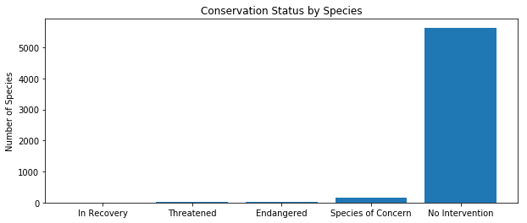
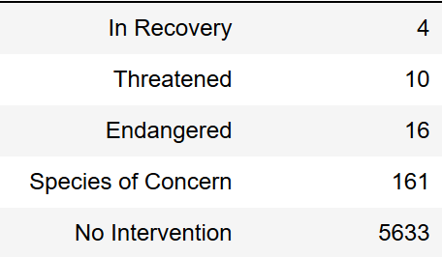
High-Level Conclusions for Conservationists
The good news is that 96.7% of tracked species require no intervention!
The bad news is that there are still 191 tracked species that require some level of protection.

Slide 5
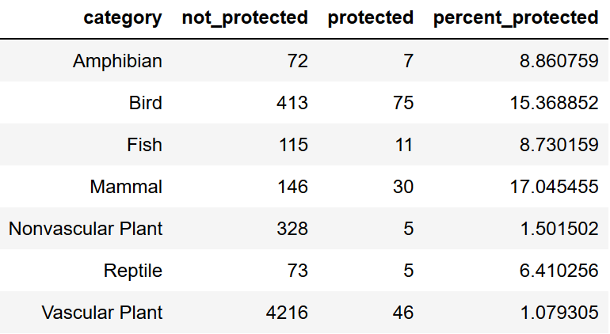
Birds and Mammals Require Attention
Mammals and Birds have the highest percentage of protected species within their category.
Chi-Squared Tests revealed no statistical difference between the percentage of tracked bird species that require protection and the percentage of tracked mammal species that require protection.
A statistically-significant difference in the protected percentage of tracked species was however noted between Birds/Mammals and other categories.

Slide 6
Birds Need More Attention than Mammals
While there is no statistically significant difference in the percentage of tracked Bird species that require protection and the percentage of tracked Mammal species that require protection, it is important to note that Birds and Mammals are not equally represented within the complete list of species being tracked.
Birds make up 9% of all tracked species while Mammals only make up 4% of tracked species. - while both categories require attention from conservation groups, birds have more than twice as many protected species to monitor than mammals and thus may require more resources to monitor.

Slide 7
Foot & Mouth Disease in Sheep Study
Conservationists in Bryce and Yellowstone National Parks are looking to see if efforts in reducing Foot & Mouth Disease in local sheep populations are effective.
Current data reflects a baseline with 15% of the sheep population samples having the disease.
With a goal of reducing the disease baseline by 5 percentage points (an effect of 33.33%) with 90% confidence, a sample size of 870 observations is required at each park to see if effects are statistically significant.

Slide 8
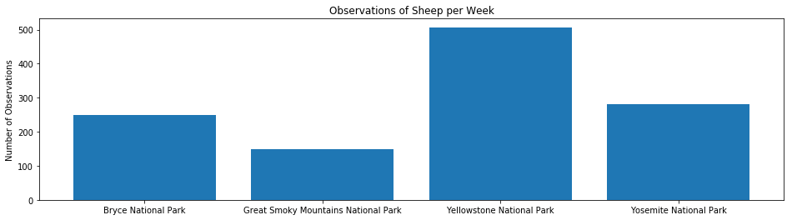
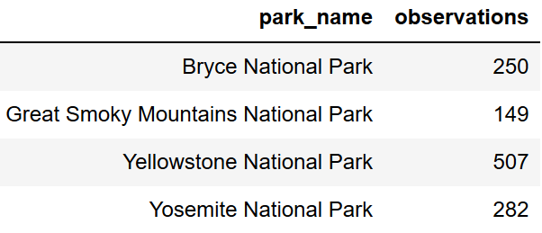
Parks Collect Samples at Different Rates
Data sample collection does not occur as quickly at each park. Highly trafficked Yellowstone National Park generates a greater number of observations per week than Bryce Canyon National Park for example.

Slide 9
Required Samples Collected within a Month
Highly trafficked Yellowstone National Park collects 507 samples a week and is expected to collect the required 870 samples within 1.7 weeks.
The less frequented Bryce National Park only collects 250 samples a week and is expected to need 3.5 weeks in order to collect the required 870 samples.
For the study as a whole, the data collection required to infer whether conservation efforts are making a statistically significant impact in reducing the disease should be completed within a month.

Slide 10
Conclusions for Conservationists
Directing Conservation Efforts for Protected Species
96.7% of tracked species require no intervention from conservationists!
17% and 15% of tracked Mammal and Bird species (respectively) require protection
There is no statistically-significant difference in percentage of protected species between the two categories.
However, Birds make up 9% of all tracked species while Mammals only make up 4% of tracked species.
All other considerations assumed to be equal, this suggesting that Bird conservation groups may require roughly twice as many resources as Mammal groups do.
Facilitating a Foot & Mouth Disease Study in Sheep Populations
To statistically assert that new efforts are reducing the occurrence of the disease within the Sheep population from 15% to 10%, 870 samples must be collected in each park.
The study should have collected enough samples within 1.7 weeks in Yellowstone and within 3.5 weeks in Bryce National Park in order to test the effects of new efforts to reduce occurrence of the disease.

